Slide 1
Designing Page Layouts
customizing the layout of publishing pages
Notes:
This lecture steps through the process of designing and implementing page layouts from start to finish. You will learn about the fundamentals of creating site columns and content types and discover how to leverage the useful site columns and content types provided by the Publishing features of SharePoint Server 2010. You will also learn essential techniques in SharePoint Designer 2010 for creating and implementing custom page layouts such as creating field controls by dragging and dropping site columns from the toolbox. This lecture also discusses configuring Publishing sites to enable and disable the use of specific page layouts and site templates and demonstrates techniques for designing page layouts with Web Part Zones for scenarios where it makes sense to allow users to add Web Parts to Publishing pages.

Slide 2
Agenda
Page Layouts Overview
Site Columns and Content Types
Creating a New Page Layout with SPD
Configuring Page Layouts and Site Templates
Web Parts

Slide 3
Page Layouts
Page layouts are publishing page templates
They extend template layout of an existing master page
They define constrains for content to be added & edited
They define layout for editing mode and display mode
v4.master
Products.aspx
Product Name
Product Description
Product Picture
Product Discounts
Notes:
Page layouts serve as a second layering of templates for publishing pages. That's because they extend template layout of an existing master page.
A page layout is based on a content type that defines the constrains for any content which is added and edited by content authors. The page layout itself defines a user interface with a layout for editing mode and for display mode.

Slide 4
Page Layouts and Content Types
Each page layout is based on a content type
Content type defines collection of site columns
Page layout has field control bound to each site column
Page layout may optionally include Web Part zone(s)
ProductLayout.aspx
Field control 1
Field control 2
Field control 3
Product Page content type
Field Control 4
Site Columns (aka Fields collection)
Site Column 1
Site Column 2
Site Column 3
Site Column 4
Web Part zone
Notes:
Each page layout is based on an associated content type. Whenever you create or upload a page layout, you must assign a content type to it at that point.
A content type defines the schema for form data using a collection of site columns. At a high level, the architecture for a page layout has field control that is bound to each site column in the underlying content type.
In addition to field controls, a page layout may optionally include Web Part zones. This provides flexibility as a content author has much more freedom to add all kinds of Web Parts and to customize them as desired.

Slide 5
Content Type Can Have Many Page Layouts
Multiple page layouts can use same content type
Provides alternative ways to layout the same content
Product Page content type
Site Columns (aka Fields collection)
Site Column 1
Site Column 2
Site Column 3
Site Column 4
ProductLayout1.aspx
ProductLayout2.aspx
ProductLayout3.aspx
Field control 1
Field control 1
Field control 1
Field control 2
Field control 3
Field control 3
Field control 2
Field control 2
Field Control 4
Field Control 4
Field control 3
Field Control 4
Notes:
Note that more than one page layouts can be associated with a single content type. This possibility makes it possible to show the same content in different ways.
For example, a content author can create a publishing page based on one page layout and then switch to another. As long as both page layouts are based on the same content type or the same set of columns, the displays the exact same information, just in different ways.

Slide 6
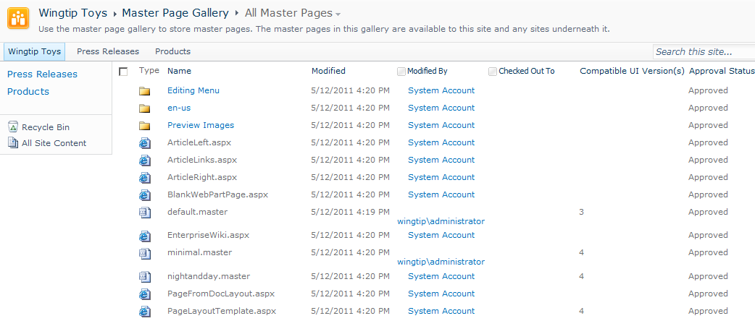
Where do Pages Layouts Live?
Page Layouts deployed to Master Page Gallery
Page layout can be used in current site
Page layout can be used in all descendant sites
Page layout in top site usable throughout site collection
Notes:
Page Layouts must be deployed to the Master Page Gallery. Once a page layout has been deployed to the Master Page Gallery of a specific site, it can be used in current site as well as in all descendant sites. A page layout that has been deployed in the top level site can be used in all sites throughout the current site collection.

Slide 7
DEMO
Examining the Out-of-box Page Layouts

Slide 8
Agenda
Page Layouts Overview
Site Columns and Content Types
Creating a New Page Layout with SPD
Configuring Page Layouts and Site Templates
Web Parts

Slide 9
Site Columns
Reusable column templates that define…
The underlying field type for column value
The default value
Rendering characteristics
Each site has its own Site Column Gallery
Site columns available in current site and sites below
Site columns in top site available to site collection
Notes:
A site column represents the definition for a reusable column templates. Each site column defines an underlying field type for column value, a default value and the rendering characteristics for that field type. For example, a site column based on the underlying field type of Currency can defined the formatting in terms of US Dollars.
Each site has its own Site Column Gallery. This is true of both top level sites as well as child sites. A site column in the site column gallery is available for use in current site and in child sites below in the site hierarchy. A site column in the site column gallery of the top-level site is available for use throughout the entire site collection.

Slide 10
OOB Site Columns for Publishing Sites
Site Columns | Field Type | Group
Byline | Single line of text | Page Layout Columns
Image | Caption Publishing HTML | Page Layout Columns
Page Content | Publishing HTML | Page Layout Columns
Page Icon | Publishing Image | Page Layout Columns
Page Image | Publishing Image | Page Layout Columns
Redirect URL | Hyperlink or Picture | Page Layout Columns
Rollup Image | Publishing Image | Page Layout Columns
Summary Links | Summary Links | Page Layout Columns
Summary Links 2 | Summary Links | Page Layout Columns
Article Date | Date and Time | Publishing Columns
Contact | Person or Group | Publishing Columns
Contact E-Mail Address | Single line of text | Publishing Columns
Contact Name | Single line of text | Publishing Columns
Contact Picture | Hyperlink or Picture | Publishing Columns
Scheduling End Date | Publishing Schedule End Date | Publishing Columns
Scheduling Start Date | Publishing Schedule Start Date | Publishing Columns
Target Audiences | Audience Targeting | Publishing Columns
Notes:
This slides shows the site columns included with SharePoint 2010 that are specifically intended for use with publishing sites and page layouts. The site columns listed at the top with a Group value of Page Layout Columns are used by some of the out-of-the-box page layouts and you can optionally use them as well behind your custom page layouts.
The site columns listed at the top with a Group value of Publishing Columns are all part of the Page content type from which all other publishing content types must inherit. That means that each site column in the Publishing Columns group represents a column value that is guaranteed to exist behind every publishing page. In other words, these site columns are not optional. They are always used.

Slide 11
Content Types
Reusable item/document templates that define…
A parent content type
A collection of site columns (aka fields)
Each site has its own Content Type Gallery
Content types available in current site and sites below
Content types in top site available to site collection
Notes:
A content type is a reusable template of site columns used for an item or document. Since we are concentrating on publishing sites in this course, we are interested in content types that are used behind the Pages document library.
Each content type lives in a large hierarchy of content types and therefore must be defined with a parent content type. The content type inherits a set of site columns from its parent content type can add more of its own.
Just like site columns, content types are tracked in a content type gallery. Each site within a site collection has its own Content Type Gallery. Content types in a content type gallery are available in current site as well as in child sites below in the sire hierarchy. Content types that have been added to the content type gallery of the top-level site are available for use throughout the current site collection.

Slide 12
Content Type Inheritance
Publishing page content types inherit from Page
Welcome Page and Article Page provides out of box
Custom content types should inherit from Page as well
Item
Document
System Page
Page
Welcome Page
Article Page
Landing Page
Custom Content Types
Product Page
Notes:
The content types associated with page layouts must inherit either directly or indirectly from a special content type named Page. As discussed earlier this lecture, the Page content type includes the following standard site columns which are automatically inherited by all Page-derived content types.
Article Date
Contact
Contact E-Mail Address
Contact Name
Contact Picture
Scheduling End Date
Scheduling Start Date
Target Audiences
There are content types provided out of the box such as Welcome Page and Article Page that demonstrate inheriting from the Page content type. Any custom content types you create for a page layout should inherit from the Page content type as well.

Slide 13
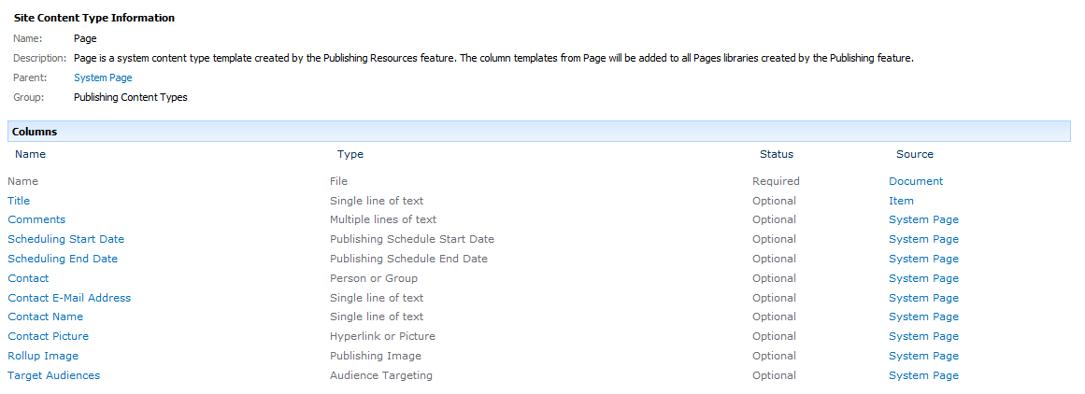
The Page Content Type
Provides common fields for all publishing pages
Most of these site columns not intended for display
Notes:
The slide shows a screenshot of the Page content type as shown through the standard user interface in a publishing site. As you can see, the Page content type includes the following standard site columns which become part of the content behind every publishing page.
Article Date
Contact
Contact E-Mail Address
Contact Name
Contact Picture
Scheduling End Date
Scheduling Start Date
Target Audiences

Slide 14
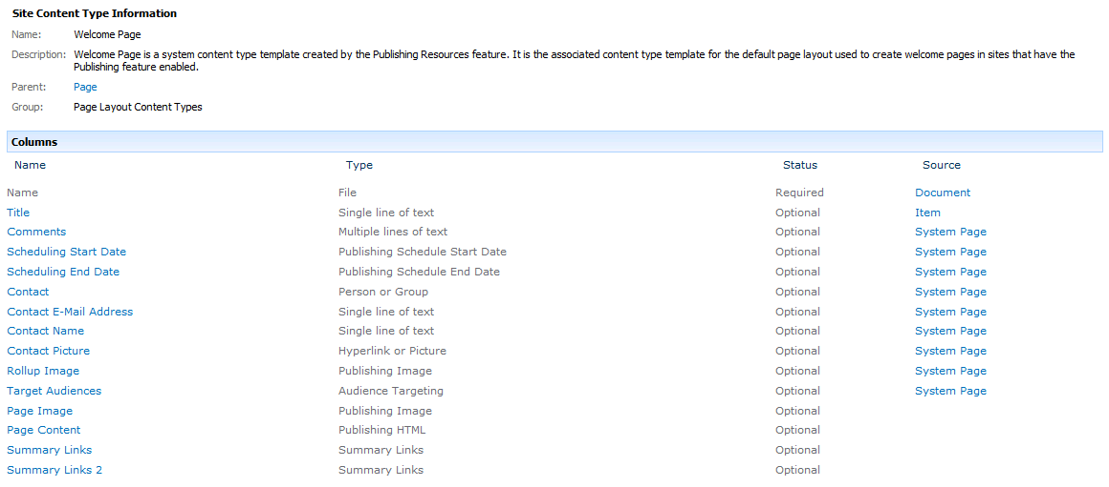
The Welcome Page Content Type
Inherits from Page content type
Adds extra site columns for home page content
Notes:
The slides shows an example of the content type named Welcome Page provided by SharePoint Server 2010 which inherits from the Page content type. The Welcome Page content type inherits all the Publishing Columns site columns from Page and adds a few more site columns of its own such as Page Image and Page Content.
This content type provides an example that is similar to the Page-derived content types that you will create for custom branding solutions.

Slide 15
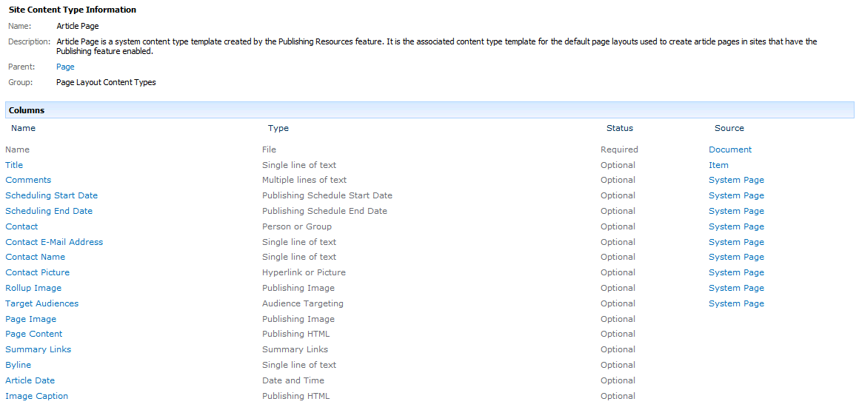
The Article Page Content Type
Inherits from Page content type
Adds extra site columns for article page content
Notes:
The slides shows a second example of the content type named Article Page provided by SharePoint Server 2010 which also inherits from the Page content type. The Article Page content type also inherits all the Publishing Columns site columns from Page and adds a few more site columns of its own.
The Welcome Page content type and the Article Page content type both add in the same site columns named Page Image and Page Content. This means page layouts based on either content type will provide values for these site columns and can be switched back and forth.

Slide 16
Creating a Custom Content Type
How do you do it?
Within site collection using browser or SPD
In a reusable feature using Visual Studio 2010
Steps
Create a content type that inherits from Page
Add extra site columns to define page content
Helpful to leverage OOB page layout columns
Page Image, Page Content, Summary Links, etc.
Notes:
You can create custom content types using the browser or SharePoint Designer. If you are a SharePoint developer, you can also create custom content types in a reusable feature using Visual Studio 2010.
Here are the basic steps.
Create a content type that inherits from Page
Add extra site columns to define page content
Associate the content type with one or more page layouts to make it useful
Note that it can be beneficial to leverage standard site columns from the Page Layout Columns group such as Page Image, Page Content and Summary Links. To create content types which are compatible with standard Page-derived content types such as Welcome Page and Article Page.

Slide 17
DEMO
Creating Site Columns and Content Types

Slide 18
Agenda
Page Layouts Overview
Site Columns and Content Types
Creating a Page Layout with SPD
Configuring Page Layouts and Site Templates
Web Parts

Slide 19
Steps to Create a New Page Layout
Create site columns
Create content type
Add created site columns to content type
In the Master Page Gallery
Create new Page Layout file
Check-out file and edit in SharePoint Designer
Populate the file with content fields
Check-in and approve
Use the new page layout file
Notes:
Once you have create the required Page-derived content type, you can then create the page layout itself using SharePoint Designer. SharePoint Designer provides a very friendly environment for create a page layout because you can drag and drop the site columns from the associated content type to easily create bound field controls.
Here are the steps you will go through in the lab
Create the extra site columns required for tracking content
Create the Page-derived content type
Add any required site columns to the Page-derived content type
Create a new page layout file in the master page gallery of target site
Check-out file and edit in SharePoint Designer
Populate the page layout with field controls associated with specific site columns
Check in the page layout and approve it
Configure publishing pages to use the new page layout

Slide 20
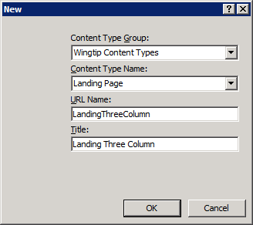
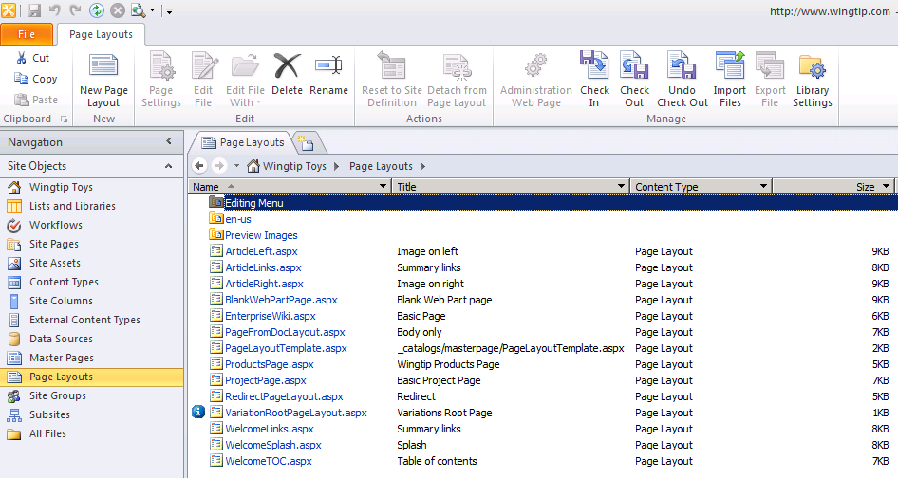
Creating a New Page Layout
SPD provides New Page Layout command
Select Page-derived content type
Give new Page Layout an URL, Name and Title
Notes:
This slide shows the user interface experience in SharePoint Designer of creating a new page layout using the Page Layout command button in the ribbon. You are then prompted with a dialog that forces you to select a Page-derived content type and to type in a value for the new page layout's URL, Name and Title.

Slide 21
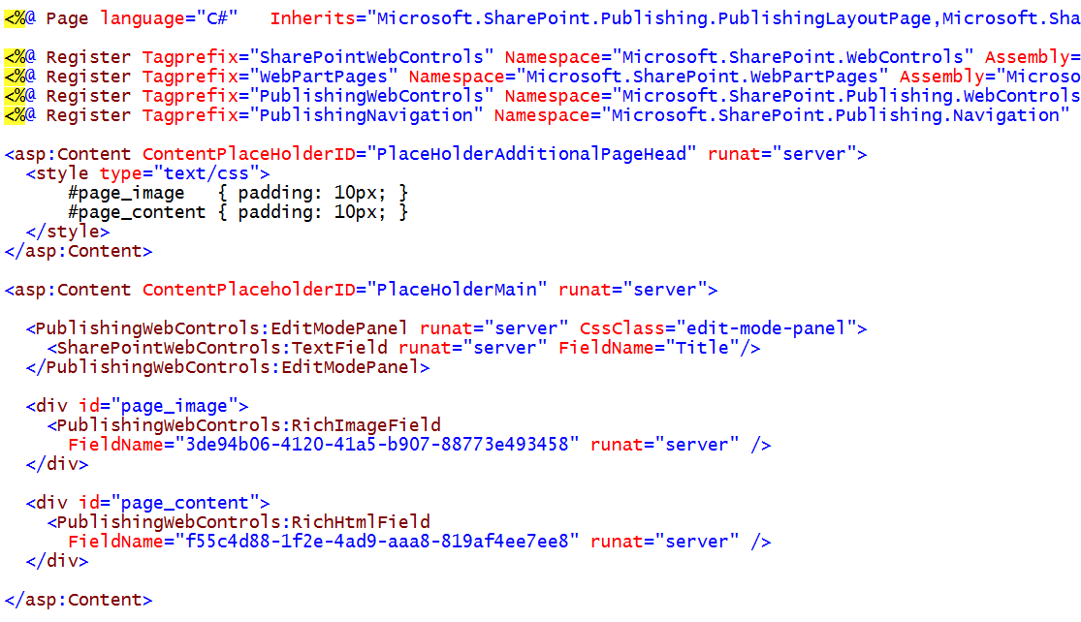
A Simple Page Layout
Notes:
This is an example of what a page layout looks like when you are editing it with Code view in SharePoint Designers. Note that the page layout is like a site page because you add placeholders such as PlaceHolderMain and PlaceHolderAdditionalPageHead.
Note that as PlaceHolderMain in this example contains example of field controls such as PublishingWebControls:RichImageField and PublishingWebControls:RichTextField. Also note that each of these field controls is configured with a GUID assigned to the FieldName attribute which effectively binds it to a underlying site column.

Slide 22
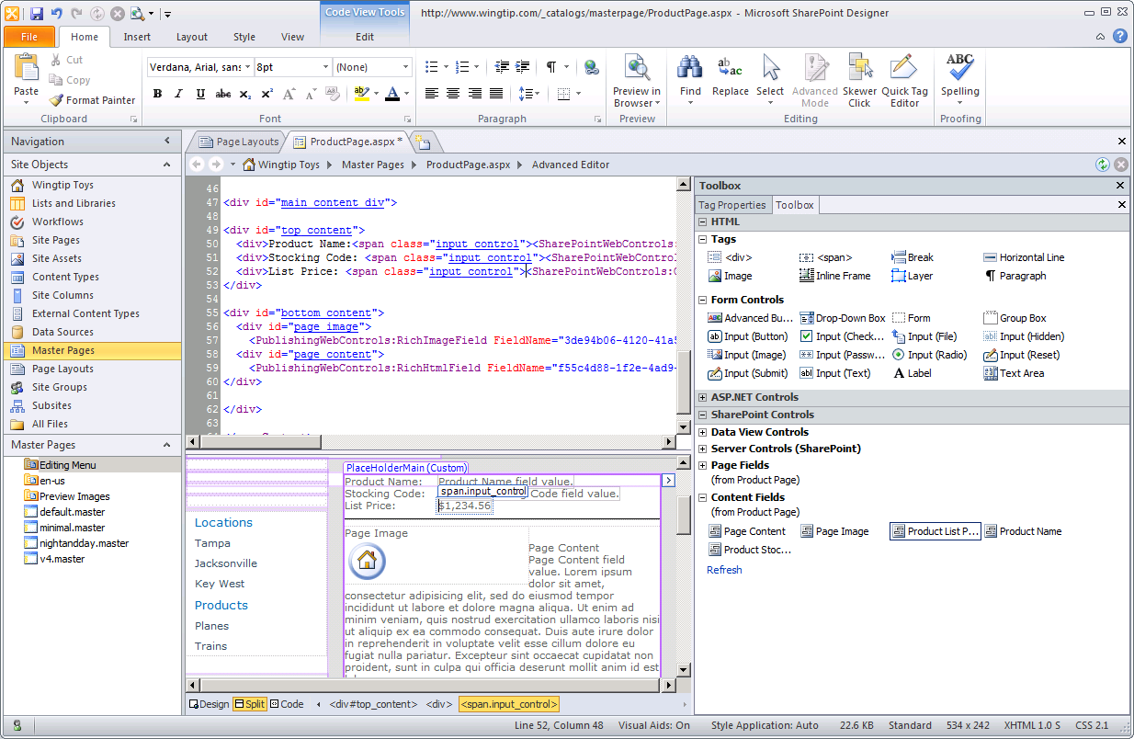
Adding Field Controls in SPD
Notes:
When creating and modifying page layouts in SharePoint Designer, the toolbox provides a Content Fields section which allows you to drag and drop site columns on the page layout to create pre-bound field controls like the ones shown on the previous slide.

Slide 23
DEMO
Creating and Designing Page Layouts

Slide 24
Agenda
Page Layouts Overview
Site Columns and Content Types
Creating a New Page Layout with SPD
Configuring Page Layouts and Site Templates
Web Parts

Slide 25
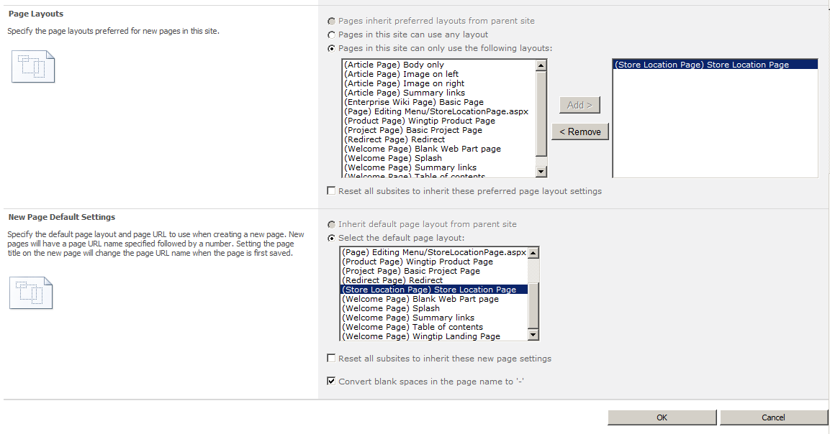
Configuring Page Layouts for a Site
Notes:
Each site provides an administration page to configure which page layouts can be used in that site. This makes it possible to hide page layouts from the top level site that are inappropriate to use in the current child site.]
It is also possible to select a default page layout. The use of a configured default page layout can make things easier as the content author will not have to change the page layout after creating a new page.

Slide 26
DEMO
Configuring The Page Layouts for a Site

Slide 27
Agenda
Page Layouts Overview
Site Columns and Content Types
Creating a New Page Layout with SPD
Configuring Page Layouts and Site Templates
Web Parts

Slide 28
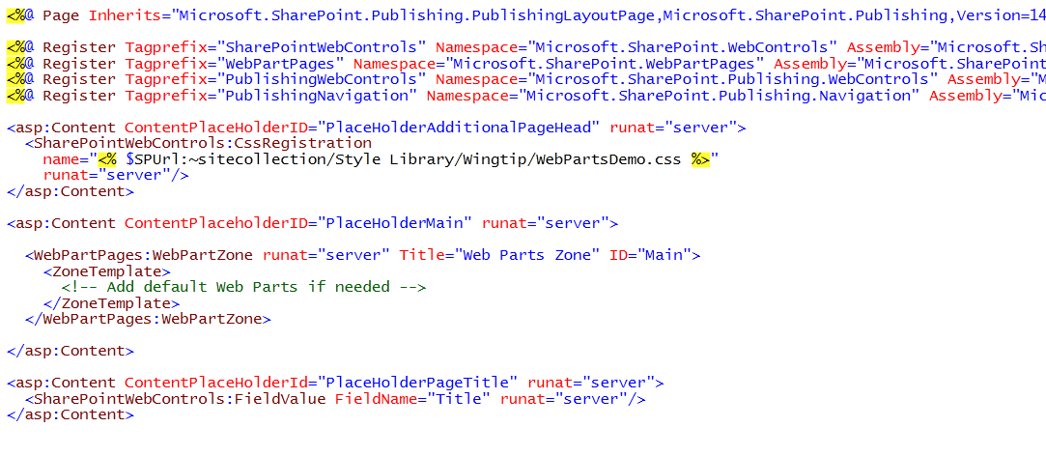
Web Parts and Web Part Zones
Page Layouts can have zones
Makes it possible to use out-of-box Web Parts
Notes:
Just like Web Parts in collaboration sites, Web designers can add Web Part zones which enable content authors to insert/modify Web Parts with these zones. Doing so removes constraints and provides much more flexibility to the content authors. This flexibility and lack of constraint can be good or bad depending on the scenario and how much trust should be given to content authors to do the right thing with the extra freedom.

Slide 29
DEMO
Adding Web Part Zones to a Page Layout

Slide 30
Summary
Page Layouts Overview
Site Columns and Content Types
Creating a New Page Layout with SPD
Configuring Page Layouts and Site Templates
Web Parts

